Slide 1
Investigating the 3rd Party Android Apps
Part 2: TextNow
Notes:
https://digitalcorpora.s3.amazonaws.com/corpora/mobile/android_10/Non-Cellebrite%20Extraction/Pixel%203.zip

Slide 2
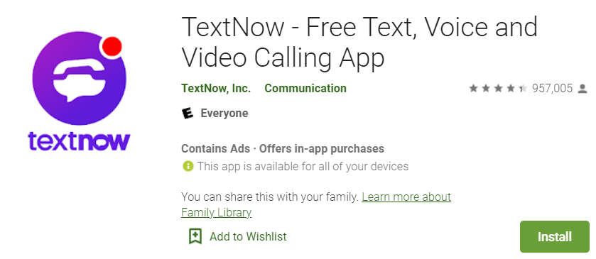
What is textnow app?

Slide 3
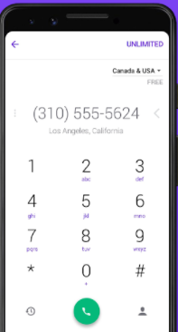
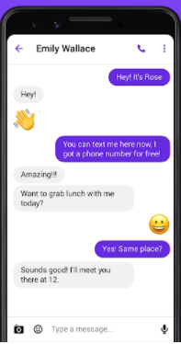
Textnow features
Offers users a local second phone number
Free calls, video calls, text messages
Evidence types:
Username
Messages
Contacts
Phone numbers

Slide 4
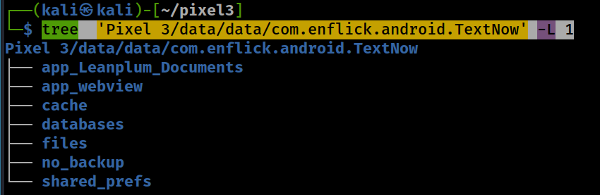
TextNew file structure
Notes:
tree 'Pixel 3/data/data/com.enflick.android.TextNow' -L 1

Slide 5
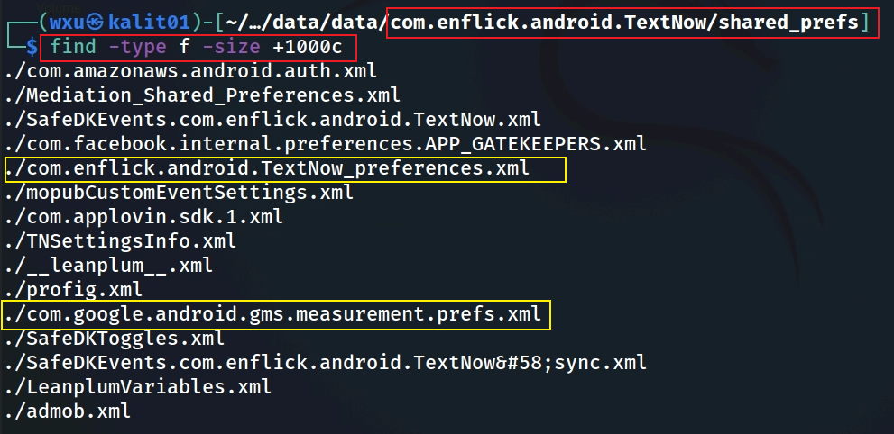
Shared preference files

Slide 6
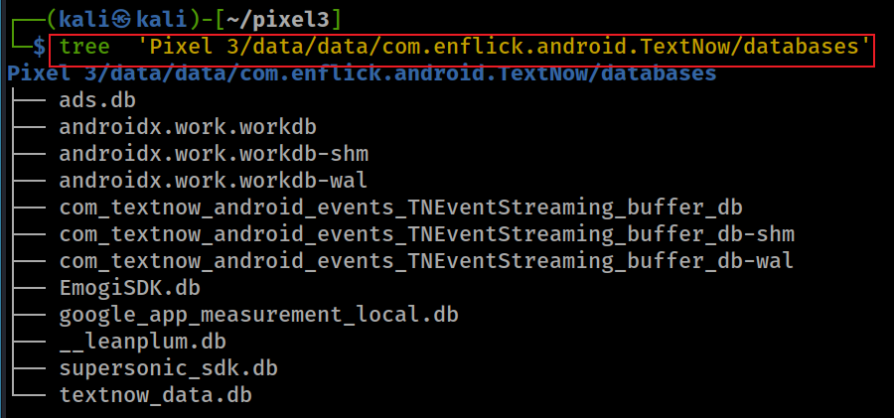
Databases
The most valuable database
textnow_data.db
help understand user activity and communications.
Contains core app data
Messages
Call logs
Contacts

Slide 7
Sample questions
What is the phone number that is associated with TextNow?
What is the username?
How many contacts are saved in TextNow?
Are they conversations between 2-4 pm (local time)?

Slide 8
Investigate com.enflick.android.TextNow_preferences.xml

Slide 9
What phone number is associated with textnow app?
search the username associated with the app
Notes:
grep 'phone' 'Pixel 3/data/data/com.enflick.android.TextNow/shared_prefs/com.enflick.android.TextNow_preferences.xml'

Slide 10
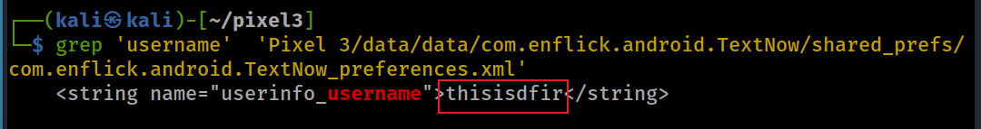
What is the username for textnow?
search the username associated with the app
Notes:
grep 'username' 'Pixel 3/data/data/com.enflick.android.TextNow/shared_prefs/com.enflick.android.TextNow_preferences.xml'

Slide 11
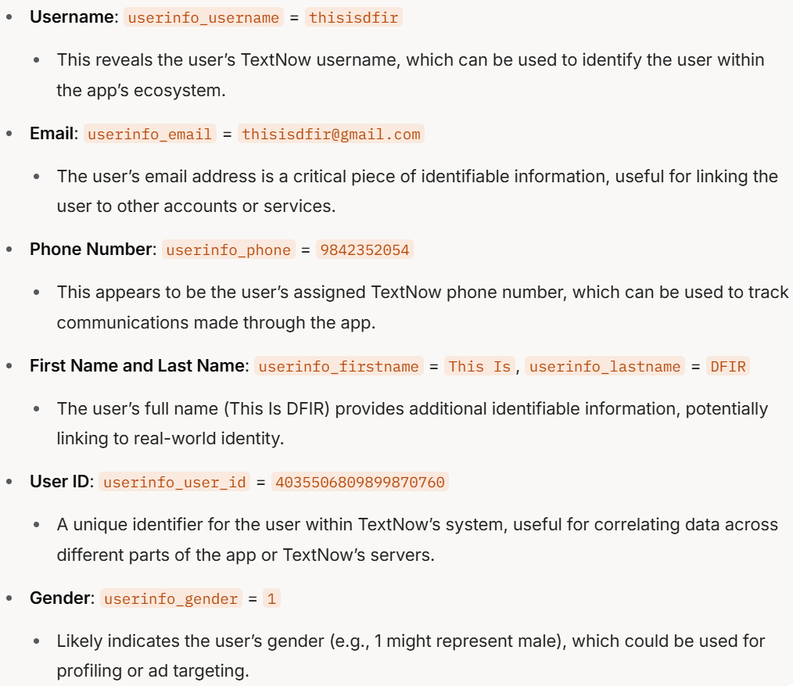
Summary 1: User Identity and Personal Information
Notes:
The provided text is a Shared Preferences XML file from the `shared_prefs/` directory of the TextNow app on a Pixel 3 device (`Pixel 3/data/data/com.enflick.android.TextNow/shared_prefs/`). This XML file contains key-value pairs that store various user settings, app states, and potentially sensitive data. Below is a summary of the most valuable forensic information that can be extracted from this file, focusing on data that could be useful for understanding user identity, behavior, communications, and app usage.
### Most Valuable Forensic Information
#### 1. User Identity and Personal Information
- **Username**: `userinfo_username` = `thisisdfir`
- This reveals the user’s TextNow username, which can be used to identify the user within the app’s ecosystem.
- **Email**: `userinfo_email` = `thisisdfir@gmail.com`
- The user’s email address is a critical piece of identifiable information, useful for linking the user to other accounts or services.
- **Phone Number**: `userinfo_phone` = `9842352054`
- This appears to be the user’s assigned TextNow phone number, which can be used to track communications made through the app.
- **First Name and Last Name**: `userinfo_firstname` = `This Is`, `userinfo_lastname` = `DFIR`
- The user’s full name (This Is DFIR) provides additional identifiable information, potentially linking to real-world identity.
- **User ID**: `userinfo_user_id` = `4035506809899870760`
- A unique identifier for the user within TextNow’s system, useful for correlating data across different parts of the app or TextNow’s servers.
- **Gender**: `userinfo_gender` = `1`
- Likely indicates the user’s gender (e.g., 1 might represent male), which could be used for profiling or ad targeting.
#### 2. Communication Details
- **Last Called Number**: `userinfo_last_number_called` = `+19842032223`, `LAST_CALL_DESTINATION` = `+19842032223`
- The phone number `+19842032223` was the last number called, providing insight into the user’s recent communications.
- **Last Call UUID**: `LAST_CALL_UUID` = `ad215984-b355-4629-b2e8-0773ab0a098a`
- A unique identifier for the last call, which could be used to retrieve more details about the call (e.g., duration, type) from other databases like `textnow_data.db`.
- **Last Call Time**: `LAST_CALL_TIME` = `1581192458738`
- This timestamp (February 8, 2020, 19:27:38 UTC) indicates when the last call was made, useful for establishing a timeline of user activity.
- **Latest Message ID**: `userinfo_latest_msg_id` = `30102870972`
- Indicates the ID of the most recent message, which can be cross-referenced with the `textnow_data.db` database to retrieve message content or metadata.
- **Voicemail**: `userinfo_voicemail` = `1`
- Suggests the user has one voicemail, which might contain additional audio data or messages.
#### 3. Timestamps and Activity Timeline
- **First Home (App Usage Start)**: `userinfo_first_home` = `2020-02-08T14:54:52.463-05:00`
- Indicates the first time the user accessed the app’s home screen (February 8, 2020, 14:54:52 EST), marking the start of app usage.
- **Last Update**: `userinfo_last_update` = `2020-02-08`
- The last time user info was updated, aligning with the first home timestamp, suggesting this might be a new or recently active user.
- **Last Contacts Fetch**: `last_contacts_get_millis` = `1581645128462` (February 14, 2020, 00:32:08 UTC)
- The last time the app fetched the user’s contacts, which could indicate when the user last synced or accessed their contact list.
- **User Drawer State Reported**: `user_drawer_state_reported_timestamp` = `1581645128481` (February 14, 2020, 00:32:08 UTC)
- Likely the last time the app reported the state of the navigation drawer, indicating recent app interaction.
#### 4. Account and App Configuration
- **Account Status**: `userinfo_account_status` = `ENABLED`
- Confirms the user’s account is active, meaning the app was functional at the time of data extraction.
- **Account Balance**: `userinfo_account_balance` = `0`, `userinfo_account_balance_currency` = `USD`
- The user has no balance in their TextNow account, which might indicate limited use of premium features.
- **TextNow Credit**: `userinfo_textnow_credit` = `10`
- The user has 10 credits, which might be used for in-app purchases or features.
- **Registration Token**: `userinfo_registration_token` = `dGezQ94FoHs:APA91bHp7IzOKI55_XVmNu-oH5KKIdx1Y1ihGnsWzrhTAdKR1OTPqdt9exrsboVXHdvgkCaXPY5lHRdF1g2K9CialNSfx_glAiAmQj1Ndwg7N4gTS-mPMrAl3dKMla_kPKHkvErjYWxd`
- This is likely a Firebase Cloud Messaging (FCM) token used for push notifications, which can be used to track the device or link it to other Firebase services.
- **Application Version**: `application_version_code` = `13112`
- Indicates the version of the TextNow app installed, which can help identify the app’s features and potential vulnerabilities at the time of use.
#### 5. Ad and Analytics Data
- **Native Instream Ad Count**: `userinfo_native_instream_ad_count` = `{"+19842032223":2}`
- The user viewed 2 in-stream ads while interacting with the number `+19842032223`, linking ad exposure to specific contacts.
- **Last Native Ad Times**: `userinfo_last_native_ad_time` = `1581645128970` (February 14, 2020, 00:32:08 UTC), `userinfo_last_native_video_ad_impression_time` = `1581271906424` (February 9, 2020, 18:11:46 UTC)
- Timestamps of ad impressions, useful for understanding user activity and app monetization.
- **Ad Categories**: `userinfo_ad_categories` = `m_gender:m`
- Indicates the user is targeted for ads based on male gender, providing insight into ad profiling.
- **CCPA Opt-Out**: `user_has_opted_out_under_ccpa` = `false`, `user_is_covered_under_ccpa` = `false`
- The user is not covered under the California Consumer Privacy Act (CCPA) and has not opted out of data sharing, meaning their data might have been shared with third parties.
#### 6. Encrypted or Encoded Data
- **Encrypted/Encoded Strings**: Several key-value pairs appear to be encrypted or encoded, such as:
- `qayzlwx/Z/63zVrB/2XgV4Vfan3goyNTVqx+V52nAjU` = `Xq943SE5KDLigny255+OXg`
- `RyLipro7M7nuEsMghdXtKdhT5+aWtDXkXpbyL5jEK7o` = `Q6g3dLGeenvp8XvNzHbjaDPi6z8BRtD0ekOlR8fmxUMLZz8DkYfoecw+NkiydO//IK0mZmlI1n0mDOKYkQsTx9lDT2EgArhMLuYggXlXz8g`
- These might be encrypted tokens, session IDs, or other sensitive data. The keys are Base64-encoded, and the values might be encrypted or hashed. Decoding or decrypting these (if the encryption method is known) could reveal additional sensitive information, such as authentication tokens or device identifiers.
#### 7. Feature Usage and Preferences
- **Calling Support**: `is_calling_supported` = `true`
- Confirms the device supports calling, aligning with the evidence of a recent call.
- **E911 and 911 Prompt**: `userinfo_feature_e911_accepted` = `false`, `userinfo_911_prompt_accepted` = `false`
- The user has not accepted emergency calling prompts, which might indicate limited use of calling features or avoidance of emergency services.
- **Voicemail Transcription**: `vm_transcription_enabled` = `false`, `vm_transcription_user_enabled` = `false`
- Voicemail transcription is disabled, so any voicemails (e.g., the one indicated by `userinfo_voicemail`) would be audio-only.
- **Conversations Loaded**: `userinfo_conversations_loaded` = `true`
- Indicates the app has loaded the user’s conversations, suggesting the user has interacted with the messaging feature.
### Summary of Key Forensic Insights
- **User Identity**: The user is identified as "This Is DFIR" with the username `thisisdfir`, email `thisisdfir@gmail.com`, and phone number `9842352054`. Their user ID is `4035506809899870760`.
- **Communication Activity**: The user last called `+19842032223` on February 8, 2020, at 19:27:38 UTC. They have one voicemail and a recent message with ID `30102870972`.
- **Timeline**: The user started using the app on February 8, 2020, with the last significant activity (e.g., contacts fetch, ad impression) on February 14, 2020.
- **Ad Exposure**: The user viewed ads, including 2 in-stream ads related to `+19842032223`, and is targeted as male for ad purposes.
- **Privacy Settings**: The user has not opted out of data sharing under CCPA and is not covered by it, meaning their data might have been shared with third parties.
- **Encrypted Data**: Several encrypted or encoded strings might contain additional sensitive information (e.g., tokens, session IDs) if decrypted.
- **App State**: The account is enabled, the app version is `13112`, and the user has 10 TextNow credits but a $0 balance in USD.
### Recommendations for Further Investigation
- **Cross-Reference with Databases**: Use the `userinfo_latest_msg_id` and `LAST_CALL_UUID` to extract message and call details from the `textnow_data.db` database (identified as valuable in the first image).
- **Decrypt Encoded Data**: Investigate the encrypted strings (e.g., `RyLipro7M7nuEsMghdXtKdhT5+aWtDXkXpbyL5jEK7o`). If the encryption method is known (e.g., AES with a known key), these could reveal more sensitive data.
- **Voicemail Analysis**: Extract the voicemail (indicated by `userinfo_voicemail` = `1`) from the app’s storage or databases to analyze its contents.
- **Ad and Analytics Correlation**: Use the ad-related data (e.g., `userinfo_native_instream_ad_count`, `userinfo_ad_categories`) to correlate with ad databases like `ads.db` or `supersonic_sdk.db` for more insights into user behavior.
This Shared Preferences file provides a wealth of forensic data, particularly around user identity, communication history, and app usage patterns, making it a critical artifact for investigation. Would you like to explore any specific aspect further, such as decoding the encrypted strings or extracting data from related databases?

Slide 12
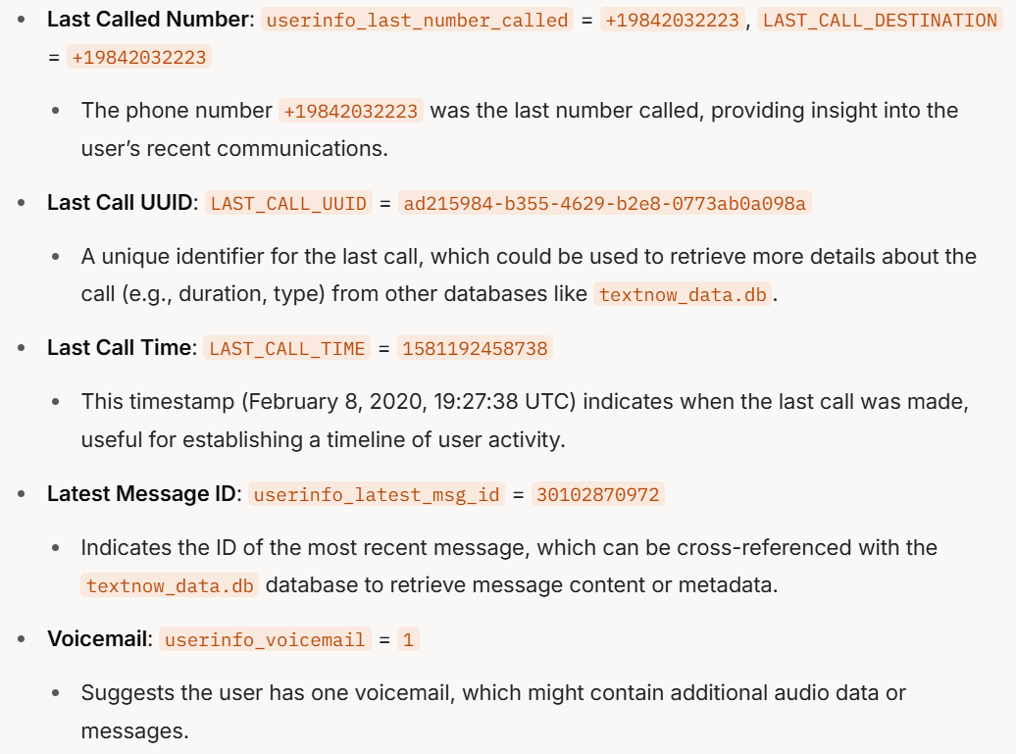
Summary 2: Communication Details
Notes:
The provided text is a Shared Preferences XML file from the `shared_prefs/` directory of the TextNow app on a Pixel 3 device (`Pixel 3/data/data/com.enflick.android.TextNow/shared_prefs/`). This XML file contains key-value pairs that store various user settings, app states, and potentially sensitive data. Below is a summary of the most valuable forensic information that can be extracted from this file, focusing on data that could be useful for understanding user identity, behavior, communications, and app usage.
### Most Valuable Forensic Information
#### 1. User Identity and Personal Information
- **Username**: `userinfo_username` = `thisisdfir`
- This reveals the user’s TextNow username, which can be used to identify the user within the app’s ecosystem.
- **Email**: `userinfo_email` = `thisisdfir@gmail.com`
- The user’s email address is a critical piece of identifiable information, useful for linking the user to other accounts or services.
- **Phone Number**: `userinfo_phone` = `9842352054`
- This appears to be the user’s assigned TextNow phone number, which can be used to track communications made through the app.
- **First Name and Last Name**: `userinfo_firstname` = `This Is`, `userinfo_lastname` = `DFIR`
- The user’s full name (This Is DFIR) provides additional identifiable information, potentially linking to real-world identity.
- **User ID**: `userinfo_user_id` = `4035506809899870760`
- A unique identifier for the user within TextNow’s system, useful for correlating data across different parts of the app or TextNow’s servers.
- **Gender**: `userinfo_gender` = `1`
- Likely indicates the user’s gender (e.g., 1 might represent male), which could be used for profiling or ad targeting.
#### 2. Communication Details
- **Last Called Number**: `userinfo_last_number_called` = `+19842032223`, `LAST_CALL_DESTINATION` = `+19842032223`
- The phone number `+19842032223` was the last number called, providing insight into the user’s recent communications.
- **Last Call UUID**: `LAST_CALL_UUID` = `ad215984-b355-4629-b2e8-0773ab0a098a`
- A unique identifier for the last call, which could be used to retrieve more details about the call (e.g., duration, type) from other databases like `textnow_data.db`.
- **Last Call Time**: `LAST_CALL_TIME` = `1581192458738`
- This timestamp (February 8, 2020, 19:27:38 UTC) indicates when the last call was made, useful for establishing a timeline of user activity.
- **Latest Message ID**: `userinfo_latest_msg_id` = `30102870972`
- Indicates the ID of the most recent message, which can be cross-referenced with the `textnow_data.db` database to retrieve message content or metadata.
- **Voicemail**: `userinfo_voicemail` = `1`
- Suggests the user has one voicemail, which might contain additional audio data or messages.
#### 3. Timestamps and Activity Timeline
- **First Home (App Usage Start)**: `userinfo_first_home` = `2020-02-08T14:54:52.463-05:00`
- Indicates the first time the user accessed the app’s home screen (February 8, 2020, 14:54:52 EST), marking the start of app usage.
- **Last Update**: `userinfo_last_update` = `2020-02-08`
- The last time user info was updated, aligning with the first home timestamp, suggesting this might be a new or recently active user.
- **Last Contacts Fetch**: `last_contacts_get_millis` = `1581645128462` (February 14, 2020, 00:32:08 UTC)
- The last time the app fetched the user’s contacts, which could indicate when the user last synced or accessed their contact list.
- **User Drawer State Reported**: `user_drawer_state_reported_timestamp` = `1581645128481` (February 14, 2020, 00:32:08 UTC)
- Likely the last time the app reported the state of the navigation drawer, indicating recent app interaction.
#### 4. Account and App Configuration
- **Account Status**: `userinfo_account_status` = `ENABLED`
- Confirms the user’s account is active, meaning the app was functional at the time of data extraction.
- **Account Balance**: `userinfo_account_balance` = `0`, `userinfo_account_balance_currency` = `USD`
- The user has no balance in their TextNow account, which might indicate limited use of premium features.
- **TextNow Credit**: `userinfo_textnow_credit` = `10`
- The user has 10 credits, which might be used for in-app purchases or features.
- **Registration Token**: `userinfo_registration_token` = `dGezQ94FoHs:APA91bHp7IzOKI55_XVmNu-oH5KKIdx1Y1ihGnsWzrhTAdKR1OTPqdt9exrsboVXHdvgkCaXPY5lHRdF1g2K9CialNSfx_glAiAmQj1Ndwg7N4gTS-mPMrAl3dKMla_kPKHkvErjYWxd`
- This is likely a Firebase Cloud Messaging (FCM) token used for push notifications, which can be used to track the device or link it to other Firebase services.
- **Application Version**: `application_version_code` = `13112`
- Indicates the version of the TextNow app installed, which can help identify the app’s features and potential vulnerabilities at the time of use.
#### 5. Ad and Analytics Data
- **Native Instream Ad Count**: `userinfo_native_instream_ad_count` = `{"+19842032223":2}`
- The user viewed 2 in-stream ads while interacting with the number `+19842032223`, linking ad exposure to specific contacts.
- **Last Native Ad Times**: `userinfo_last_native_ad_time` = `1581645128970` (February 14, 2020, 00:32:08 UTC), `userinfo_last_native_video_ad_impression_time` = `1581271906424` (February 9, 2020, 18:11:46 UTC)
- Timestamps of ad impressions, useful for understanding user activity and app monetization.
- **Ad Categories**: `userinfo_ad_categories` = `m_gender:m`
- Indicates the user is targeted for ads based on male gender, providing insight into ad profiling.
- **CCPA Opt-Out**: `user_has_opted_out_under_ccpa` = `false`, `user_is_covered_under_ccpa` = `false`
- The user is not covered under the California Consumer Privacy Act (CCPA) and has not opted out of data sharing, meaning their data might have been shared with third parties.
#### 6. Encrypted or Encoded Data
- **Encrypted/Encoded Strings**: Several key-value pairs appear to be encrypted or encoded, such as:
- `qayzlwx/Z/63zVrB/2XgV4Vfan3goyNTVqx+V52nAjU` = `Xq943SE5KDLigny255+OXg`
- `RyLipro7M7nuEsMghdXtKdhT5+aWtDXkXpbyL5jEK7o` = `Q6g3dLGeenvp8XvNzHbjaDPi6z8BRtD0ekOlR8fmxUMLZz8DkYfoecw+NkiydO//IK0mZmlI1n0mDOKYkQsTx9lDT2EgArhMLuYggXlXz8g`
- These might be encrypted tokens, session IDs, or other sensitive data. The keys are Base64-encoded, and the values might be encrypted or hashed. Decoding or decrypting these (if the encryption method is known) could reveal additional sensitive information, such as authentication tokens or device identifiers.
#### 7. Feature Usage and Preferences
- **Calling Support**: `is_calling_supported` = `true`
- Confirms the device supports calling, aligning with the evidence of a recent call.
- **E911 and 911 Prompt**: `userinfo_feature_e911_accepted` = `false`, `userinfo_911_prompt_accepted` = `false`
- The user has not accepted emergency calling prompts, which might indicate limited use of calling features or avoidance of emergency services.
- **Voicemail Transcription**: `vm_transcription_enabled` = `false`, `vm_transcription_user_enabled` = `false`
- Voicemail transcription is disabled, so any voicemails (e.g., the one indicated by `userinfo_voicemail`) would be audio-only.
- **Conversations Loaded**: `userinfo_conversations_loaded` = `true`
- Indicates the app has loaded the user’s conversations, suggesting the user has interacted with the messaging feature.
### Summary of Key Forensic Insights
- **User Identity**: The user is identified as "This Is DFIR" with the username `thisisdfir`, email `thisisdfir@gmail.com`, and phone number `9842352054`. Their user ID is `4035506809899870760`.
- **Communication Activity**: The user last called `+19842032223` on February 8, 2020, at 19:27:38 UTC. They have one voicemail and a recent message with ID `30102870972`.
- **Timeline**: The user started using the app on February 8, 2020, with the last significant activity (e.g., contacts fetch, ad impression) on February 14, 2020.
- **Ad Exposure**: The user viewed ads, including 2 in-stream ads related to `+19842032223`, and is targeted as male for ad purposes.
- **Privacy Settings**: The user has not opted out of data sharing under CCPA and is not covered by it, meaning their data might have been shared with third parties.
- **Encrypted Data**: Several encrypted or encoded strings might contain additional sensitive information (e.g., tokens, session IDs) if decrypted.
- **App State**: The account is enabled, the app version is `13112`, and the user has 10 TextNow credits but a $0 balance in USD.
### Recommendations for Further Investigation
- **Cross-Reference with Databases**: Use the `userinfo_latest_msg_id` and `LAST_CALL_UUID` to extract message and call details from the `textnow_data.db` database (identified as valuable in the first image).
- **Decrypt Encoded Data**: Investigate the encrypted strings (e.g., `RyLipro7M7nuEsMghdXtKdhT5+aWtDXkXpbyL5jEK7o`). If the encryption method is known (e.g., AES with a known key), these could reveal more sensitive data.
- **Voicemail Analysis**: Extract the voicemail (indicated by `userinfo_voicemail` = `1`) from the app’s storage or databases to analyze its contents.
- **Ad and Analytics Correlation**: Use the ad-related data (e.g., `userinfo_native_instream_ad_count`, `userinfo_ad_categories`) to correlate with ad databases like `ads.db` or `supersonic_sdk.db` for more insights into user behavior.
This Shared Preferences file provides a wealth of forensic data, particularly around user identity, communication history, and app usage patterns, making it a critical artifact for investigation. Would you like to explore any specific aspect further, such as decoding the encrypted strings or extracting data from related databases?

Slide 13
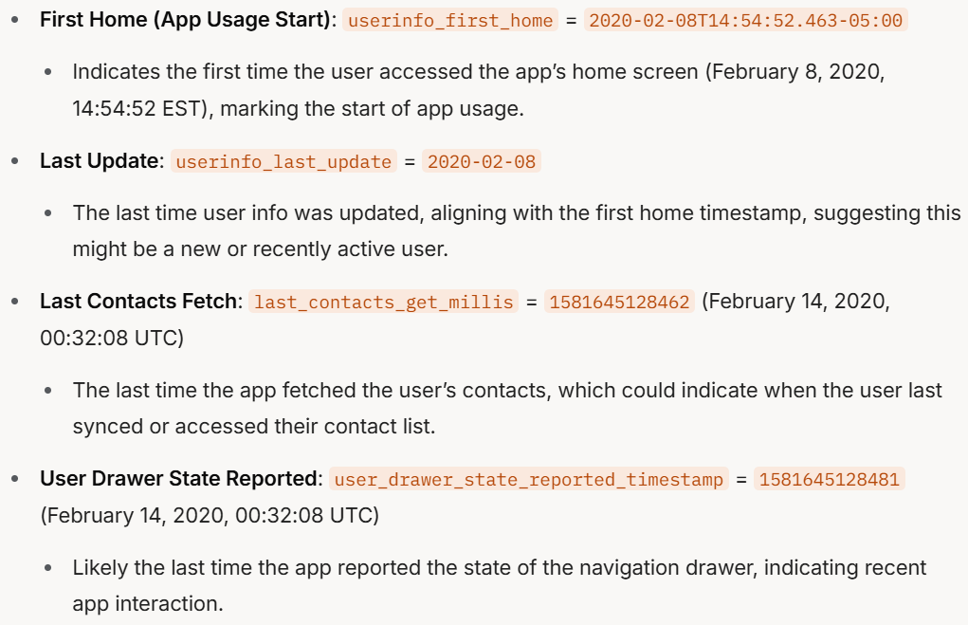
Summary 3: Timestamps and Activity Timeline
Notes:
The provided text is a Shared Preferences XML file from the `shared_prefs/` directory of the TextNow app on a Pixel 3 device (`Pixel 3/data/data/com.enflick.android.TextNow/shared_prefs/`). This XML file contains key-value pairs that store various user settings, app states, and potentially sensitive data. Below is a summary of the most valuable forensic information that can be extracted from this file, focusing on data that could be useful for understanding user identity, behavior, communications, and app usage.
### Most Valuable Forensic Information
#### 1. User Identity and Personal Information
- **Username**: `userinfo_username` = `thisisdfir`
- This reveals the user’s TextNow username, which can be used to identify the user within the app’s ecosystem.
- **Email**: `userinfo_email` = `thisisdfir@gmail.com`
- The user’s email address is a critical piece of identifiable information, useful for linking the user to other accounts or services.
- **Phone Number**: `userinfo_phone` = `9842352054`
- This appears to be the user’s assigned TextNow phone number, which can be used to track communications made through the app.
- **First Name and Last Name**: `userinfo_firstname` = `This Is`, `userinfo_lastname` = `DFIR`
- The user’s full name (This Is DFIR) provides additional identifiable information, potentially linking to real-world identity.
- **User ID**: `userinfo_user_id` = `4035506809899870760`
- A unique identifier for the user within TextNow’s system, useful for correlating data across different parts of the app or TextNow’s servers.
- **Gender**: `userinfo_gender` = `1`
- Likely indicates the user’s gender (e.g., 1 might represent male), which could be used for profiling or ad targeting.
#### 2. Communication Details
- **Last Called Number**: `userinfo_last_number_called` = `+19842032223`, `LAST_CALL_DESTINATION` = `+19842032223`
- The phone number `+19842032223` was the last number called, providing insight into the user’s recent communications.
- **Last Call UUID**: `LAST_CALL_UUID` = `ad215984-b355-4629-b2e8-0773ab0a098a`
- A unique identifier for the last call, which could be used to retrieve more details about the call (e.g., duration, type) from other databases like `textnow_data.db`.
- **Last Call Time**: `LAST_CALL_TIME` = `1581192458738`
- This timestamp (February 8, 2020, 19:27:38 UTC) indicates when the last call was made, useful for establishing a timeline of user activity.
- **Latest Message ID**: `userinfo_latest_msg_id` = `30102870972`
- Indicates the ID of the most recent message, which can be cross-referenced with the `textnow_data.db` database to retrieve message content or metadata.
- **Voicemail**: `userinfo_voicemail` = `1`
- Suggests the user has one voicemail, which might contain additional audio data or messages.
#### 3. Timestamps and Activity Timeline
- **First Home (App Usage Start)**: `userinfo_first_home` = `2020-02-08T14:54:52.463-05:00`
- Indicates the first time the user accessed the app’s home screen (February 8, 2020, 14:54:52 EST), marking the start of app usage.
- **Last Update**: `userinfo_last_update` = `2020-02-08`
- The last time user info was updated, aligning with the first home timestamp, suggesting this might be a new or recently active user.
- **Last Contacts Fetch**: `last_contacts_get_millis` = `1581645128462` (February 14, 2020, 00:32:08 UTC)
- The last time the app fetched the user’s contacts, which could indicate when the user last synced or accessed their contact list.
- **User Drawer State Reported**: `user_drawer_state_reported_timestamp` = `1581645128481` (February 14, 2020, 00:32:08 UTC)
- Likely the last time the app reported the state of the navigation drawer, indicating recent app interaction.
#### 4. Account and App Configuration
- **Account Status**: `userinfo_account_status` = `ENABLED`
- Confirms the user’s account is active, meaning the app was functional at the time of data extraction.
- **Account Balance**: `userinfo_account_balance` = `0`, `userinfo_account_balance_currency` = `USD`
- The user has no balance in their TextNow account, which might indicate limited use of premium features.
- **TextNow Credit**: `userinfo_textnow_credit` = `10`
- The user has 10 credits, which might be used for in-app purchases or features.
- **Registration Token**: `userinfo_registration_token` = `dGezQ94FoHs:APA91bHp7IzOKI55_XVmNu-oH5KKIdx1Y1ihGnsWzrhTAdKR1OTPqdt9exrsboVXHdvgkCaXPY5lHRdF1g2K9CialNSfx_glAiAmQj1Ndwg7N4gTS-mPMrAl3dKMla_kPKHkvErjYWxd`
- This is likely a Firebase Cloud Messaging (FCM) token used for push notifications, which can be used to track the device or link it to other Firebase services.
- **Application Version**: `application_version_code` = `13112`
- Indicates the version of the TextNow app installed, which can help identify the app’s features and potential vulnerabilities at the time of use.
#### 5. Ad and Analytics Data
- **Native Instream Ad Count**: `userinfo_native_instream_ad_count` = `{"+19842032223":2}`
- The user viewed 2 in-stream ads while interacting with the number `+19842032223`, linking ad exposure to specific contacts.
- **Last Native Ad Times**: `userinfo_last_native_ad_time` = `1581645128970` (February 14, 2020, 00:32:08 UTC), `userinfo_last_native_video_ad_impression_time` = `1581271906424` (February 9, 2020, 18:11:46 UTC)
- Timestamps of ad impressions, useful for understanding user activity and app monetization.
- **Ad Categories**: `userinfo_ad_categories` = `m_gender:m`
- Indicates the user is targeted for ads based on male gender, providing insight into ad profiling.
- **CCPA Opt-Out**: `user_has_opted_out_under_ccpa` = `false`, `user_is_covered_under_ccpa` = `false`
- The user is not covered under the California Consumer Privacy Act (CCPA) and has not opted out of data sharing, meaning their data might have been shared with third parties.
#### 6. Encrypted or Encoded Data
- **Encrypted/Encoded Strings**: Several key-value pairs appear to be encrypted or encoded, such as:
- `qayzlwx/Z/63zVrB/2XgV4Vfan3goyNTVqx+V52nAjU` = `Xq943SE5KDLigny255+OXg`
- `RyLipro7M7nuEsMghdXtKdhT5+aWtDXkXpbyL5jEK7o` = `Q6g3dLGeenvp8XvNzHbjaDPi6z8BRtD0ekOlR8fmxUMLZz8DkYfoecw+NkiydO//IK0mZmlI1n0mDOKYkQsTx9lDT2EgArhMLuYggXlXz8g`
- These might be encrypted tokens, session IDs, or other sensitive data. The keys are Base64-encoded, and the values might be encrypted or hashed. Decoding or decrypting these (if the encryption method is known) could reveal additional sensitive information, such as authentication tokens or device identifiers.
#### 7. Feature Usage and Preferences
- **Calling Support**: `is_calling_supported` = `true`
- Confirms the device supports calling, aligning with the evidence of a recent call.
- **E911 and 911 Prompt**: `userinfo_feature_e911_accepted` = `false`, `userinfo_911_prompt_accepted` = `false`
- The user has not accepted emergency calling prompts, which might indicate limited use of calling features or avoidance of emergency services.
- **Voicemail Transcription**: `vm_transcription_enabled` = `false`, `vm_transcription_user_enabled` = `false`
- Voicemail transcription is disabled, so any voicemails (e.g., the one indicated by `userinfo_voicemail`) would be audio-only.
- **Conversations Loaded**: `userinfo_conversations_loaded` = `true`
- Indicates the app has loaded the user’s conversations, suggesting the user has interacted with the messaging feature.
### Summary of Key Forensic Insights
- **User Identity**: The user is identified as "This Is DFIR" with the username `thisisdfir`, email `thisisdfir@gmail.com`, and phone number `9842352054`. Their user ID is `4035506809899870760`.
- **Communication Activity**: The user last called `+19842032223` on February 8, 2020, at 19:27:38 UTC. They have one voicemail and a recent message with ID `30102870972`.
- **Timeline**: The user started using the app on February 8, 2020, with the last significant activity (e.g., contacts fetch, ad impression) on February 14, 2020.
- **Ad Exposure**: The user viewed ads, including 2 in-stream ads related to `+19842032223`, and is targeted as male for ad purposes.
- **Privacy Settings**: The user has not opted out of data sharing under CCPA and is not covered by it, meaning their data might have been shared with third parties.
- **Encrypted Data**: Several encrypted or encoded strings might contain additional sensitive information (e.g., tokens, session IDs) if decrypted.
- **App State**: The account is enabled, the app version is `13112`, and the user has 10 TextNow credits but a $0 balance in USD.
### Recommendations for Further Investigation
- **Cross-Reference with Databases**: Use the `userinfo_latest_msg_id` and `LAST_CALL_UUID` to extract message and call details from the `textnow_data.db` database (identified as valuable in the first image).
- **Decrypt Encoded Data**: Investigate the encrypted strings (e.g., `RyLipro7M7nuEsMghdXtKdhT5+aWtDXkXpbyL5jEK7o`). If the encryption method is known (e.g., AES with a known key), these could reveal more sensitive data.
- **Voicemail Analysis**: Extract the voicemail (indicated by `userinfo_voicemail` = `1`) from the app’s storage or databases to analyze its contents.
- **Ad and Analytics Correlation**: Use the ad-related data (e.g., `userinfo_native_instream_ad_count`, `userinfo_ad_categories`) to correlate with ad databases like `ads.db` or `supersonic_sdk.db` for more insights into user behavior.
This Shared Preferences file provides a wealth of forensic data, particularly around user identity, communication history, and app usage patterns, making it a critical artifact for investigation. Would you like to explore any specific aspect further, such as decoding the encrypted strings or extracting data from related databases?

Slide 14
Investigate textnow_data.db

Slide 15
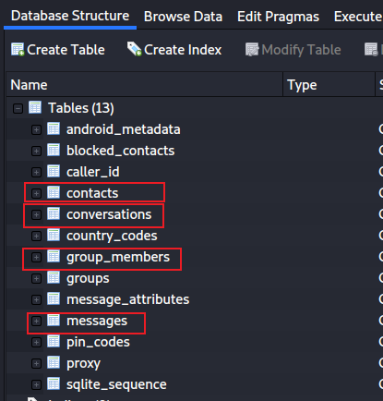
Important tables in TextNow
Show all tables in textnow_data.db
Notes:
sqlitebrowser 'Pixel 3/data/data/com.enflick.android.TextNow/databases/textnow_data.db'

Slide 16
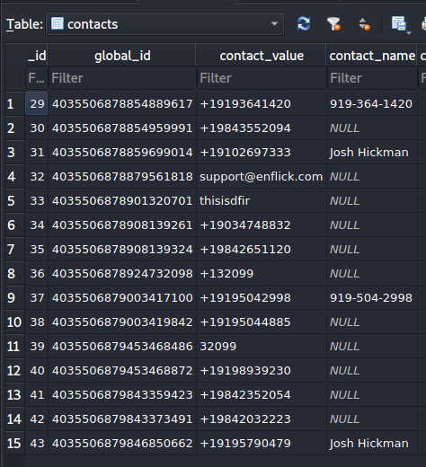
Contacts in Textnow
Contact’s phone number
Name of the contact

Slide 17
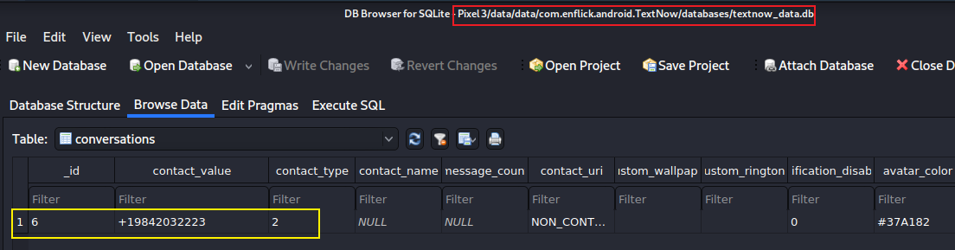
Conversations between 2-4 pm (local time)
Check conversations table
Notes:
Cmd: sqlitebrowser 'Pixel 3/data/data/com.enflick.android.TextNow/databases/textnow_data.db'

Slide 18
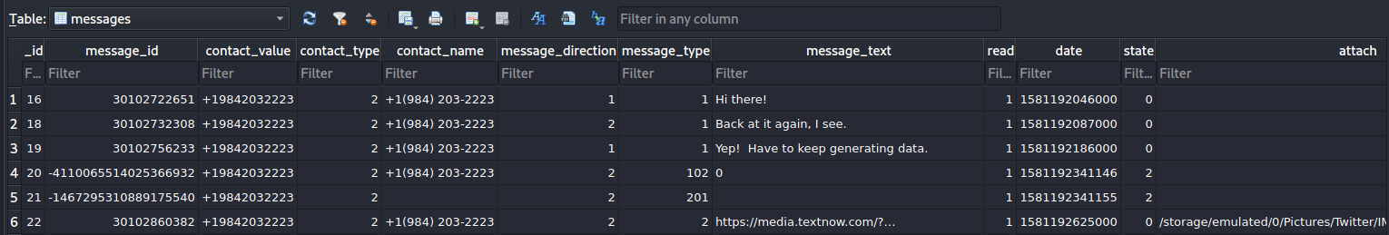
Messages in Textnow
message content
direction flag
1: received
2: sent
1: text msg
102, 201: audio
2: picture
when a message was sent
phone number of the sender ( refers to conversation table)
name of the sender (number if no names)
read flag
attachment. e.g., picture
sort by date

Slide 19
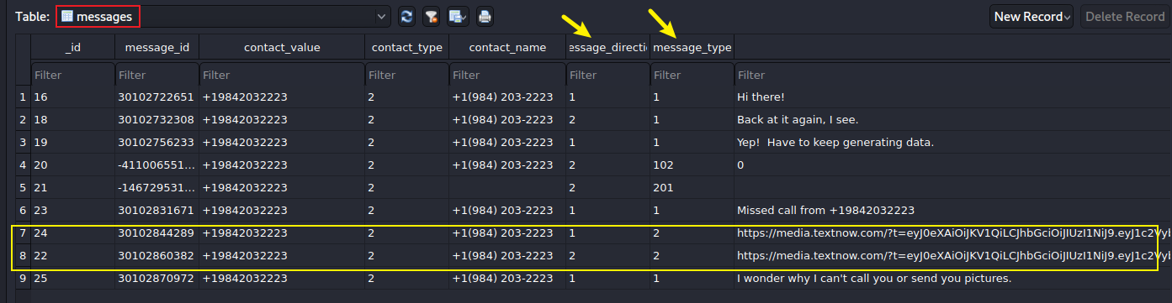
Pictures sent/received with messages
Notes:
/storage/emulated/0/Pictures/Twitter/IMG_20200203_213034.jpg

Slide 20
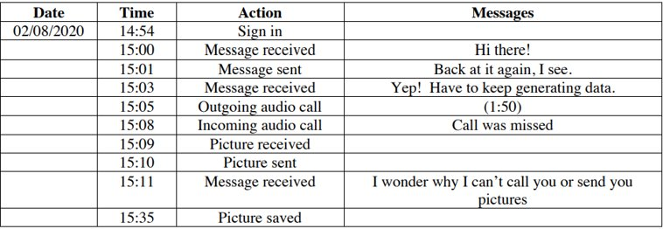
Message results

Slide 21
To summarize
Find configuration and databases of textnow
Find account information from com.enflick.android.TextNow_preferences.xml
Find the messages and contacts in textnow_data.db

